Slide 1
Evaluating the drivers of cost of care Wee Soon Nan

Slide 2
Assignment Pipeline
Data Cleaning
Bivariate Analysis of Features against Cost
Using Decision Trees Regressor models to evaluate feature importance
Feature Engineering
Discussions and Conclusion

Slide 3
Data Cleaning
Preprocessing Guidelines
Preprocessing Solutions
bill_amount.csv
Convert to DataFrame for easier processing
Identify null values
Replace null values
demographics.csv
Identify string letter case
Standardise string lase case
Identify duplicated IDs
Remove duplicate IDs
Cleaned datasets
bill_id.csv
clinical_data.csv
Identify categories in categoricals
Identify categories in categoricals
Identify mislabelled categories
Rename mislabelled categories
Identify outliers for continuous variables
Remove samples with outlier data

Slide 4
Feature Engineering
Feature | Method
Inpatient Duration | Date of Discharge – Date of Admission
Number of Medications | SUM(Pre-op Medication)
Number of Medical History | SUM(Medical History)
Number of Symptoms | SUM(Symptoms)
BMI | Weight/ Height²
Age | Date of Admission (clinical_data) - Date of Birth (demographics)
clinical_data
joined
joined
demographics

Slide 5

Processing & Merging
bill_amount
Data Processing
bill
SUM bills for each patient ID on the same date
Outlier Removal
bill_id
Keep only first admission for each patient ID
merged
For continuous variables($x$)
$$μ− 3σ<x< μ+3σ$$
2935 samples
joined

Slide 6
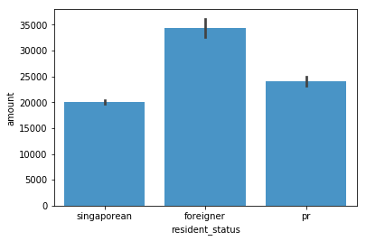
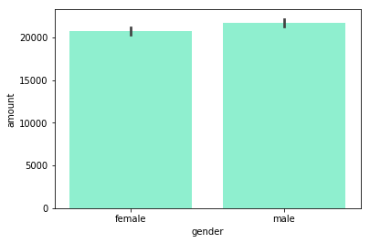
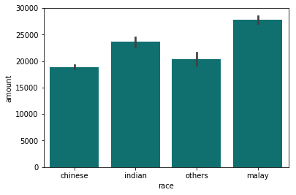
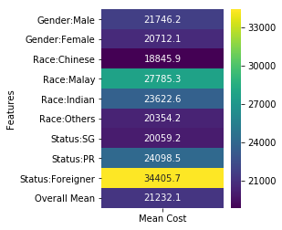
Bivariate Analysis
Foreigner resident status is indicative of higher cost
Gender differences do not contribute to differences in cost
Malay racial status is indicative of higher cost
Above overall mean :
Malay & Indian racial status,
Foreigner status

Slide 7
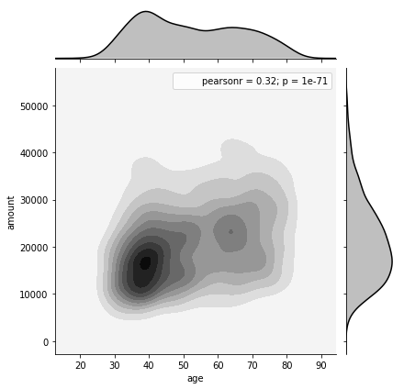
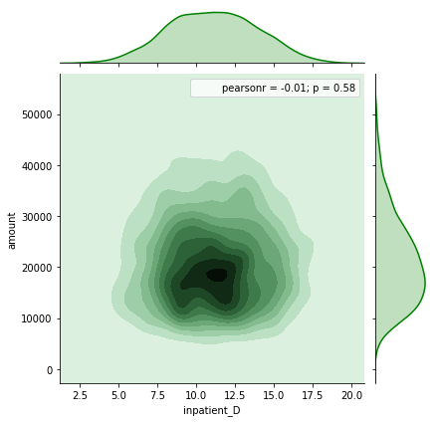
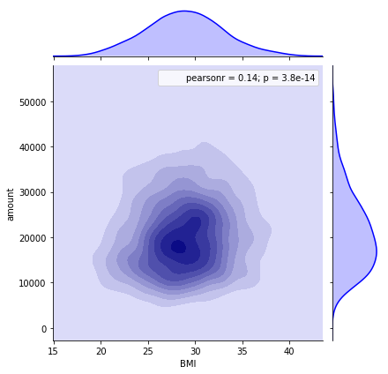
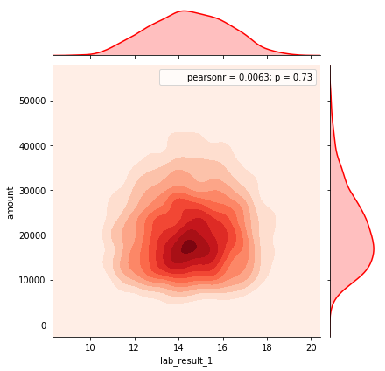
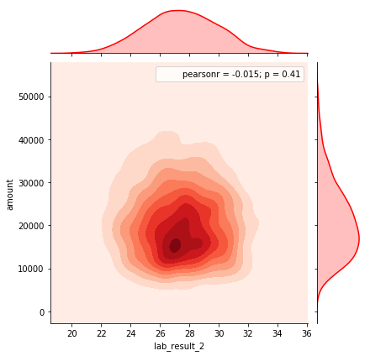
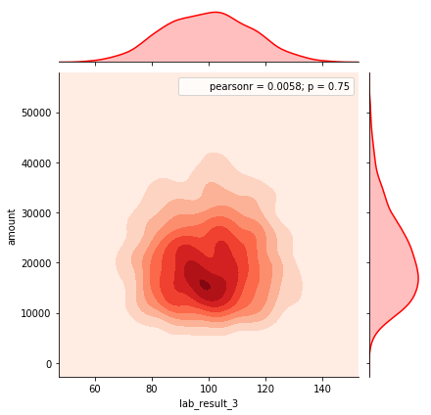
Bivariate Analysis
Feature | Pearson R-score (against cost)
Age | 0.32
Inpatient Duration | -0.01
BMI | 0.14
Lab Result 1 | 0.0063
Lab Result 2 | -0.015
Lab Result 3 | 0.0058

Slide 8
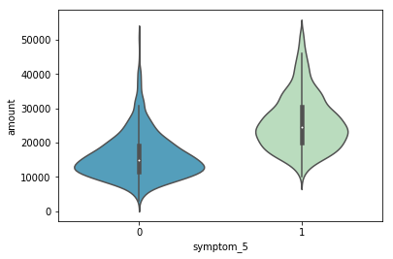
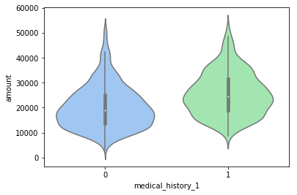
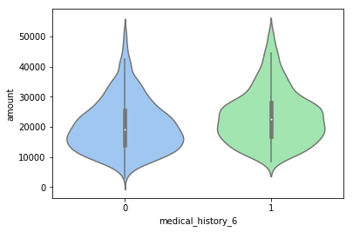
Bivariate Analysis
Violin plots were plotted for all indicator categoricals:
→Symptom
→Medical History
→Preop Medication
3 categories showed a slight increase in patient bill cost when present (value == 1):
Symptom 5
Medical History 1 Medical History 6

Slide 9
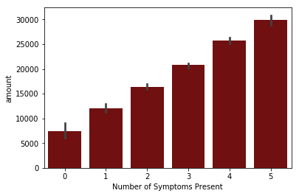
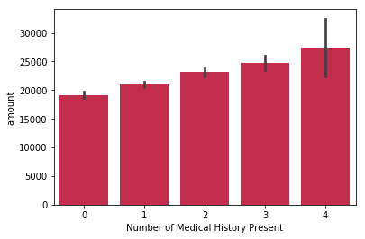
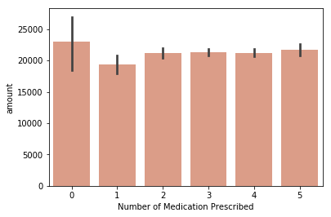

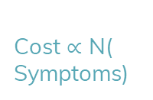
Bivariate Analysis
Cost $∝$ N( Symptoms)
Cost $∝$
N( Medical History)
Cost does not increase linearly with
N(Preop medications)

Slide 10
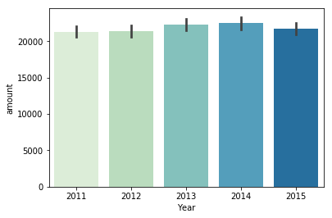
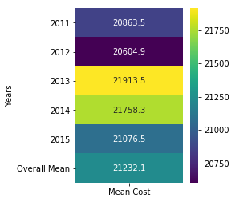
YOY Analysis
To determine if rising costs were attributed to general inflation or potentially rising costs of drugs/treatments.
Mean cost in 2013 went above the overall Mean cost
Year could be a categorical variable affecting cost of care

Slide 11
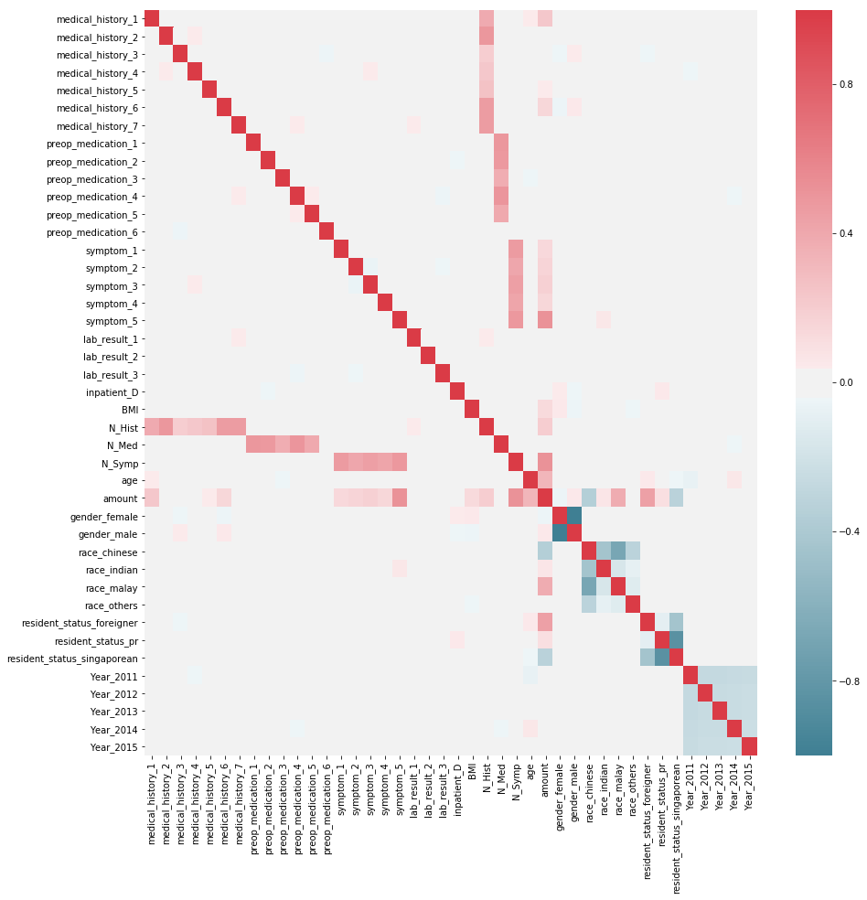
Correlation Analysis
Observing the amount row, a few features are positively correlated with cost of care:
medical_history_1, 5 & 6
Symptom 1 – 5
BMI
N(medical history)
N(symptom)
Age
Malay & Indian racial status
Foreigner resident status
These features are likely to be drivers of cost of care

Slide 12
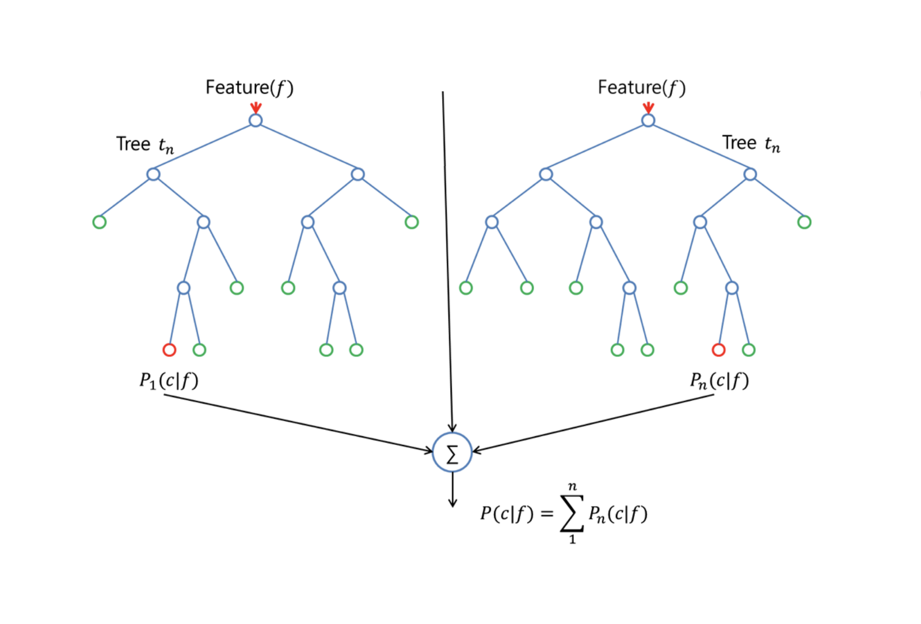
Random Forest Regressor
Random Forest Models:
Build several decision trees, which are averaged to build classification and regression models.
→ Bootstraps training set
→ Chooses “best” feature at each node
Extra Trees Regressor Models:
Modification of Random Forest:
→ No bootstrapping = lower bias
(from bootstrapping training set)
→ Randomly chooses feature at each node = further reduces variance of the model

Slide 13
Feature selection strategy
Advantage of RF Regressor Models:
Inherent feature selection capabilities
→ compute mean square error (MSE) decrease for each predictor in each tree to choose the optimal cut-point
→ Identify most important features by ranking the decrease
Limitations of RF models for feature selection:
→ Biased towards features with more categories
→Artificially lowered importance ranking for correlated features if one of the correlated feature is chosen first during decision tree building

Slide 14
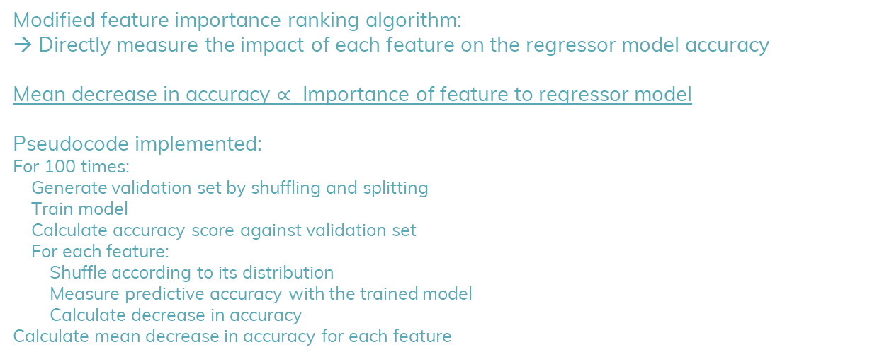
Improving feature importance ranking
Modified feature importance ranking algorithm:
→ Directly measure the impact of each feature on the regressor model accuracy
Mean decrease in accuracy $∝$ Importance of feature to regressor model
Pseudocode implemented:
For 100 times:
Generate validation set by shuffling and splitting
Train model
Calculate accuracy score against validation set
For each feature:
Shuffle according to its distribution
Measure predictive accuracy with the trained model
Calculate decrease in accuracy
Calculate mean decrease in accuracy for each feature

Slide 15
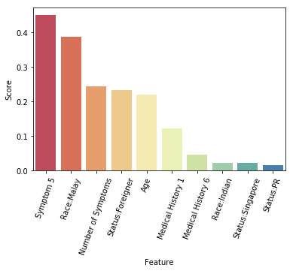
Feature Importance Results
Rank:
Symptom 5
Malay Racial Status
Number of Symptoms
Foreigner Status
Age
Results of regressor model feature selection strategy validates results of bivariate and correlation analysis

Slide 16
Discussion
Malay Racial Status
Malays form a large proportion of dialysis patients (24.4%)
Foreigner Status
Singapore is a global medical tourism; foreigners are more willing to pay expensive treatments
Foreigners don’t receive subsidies or reimbursements from the Government, increasing the cost of care they have to pay
Correlation with high costs most likely stems from underlying factor of high prevalence of unhealthy behaviour (smoking)

Slide 17
Conclusion
The key driver of cost of care identified from this dataset is the presence of symptom 5.
Number of symptoms a patient exhibits is the next strongest driver of cost of care, along with age.
Although Malay racial status is also indicative of higher cost of care, the underlying driver of cost of care most likely stems from unhealthy behaviour prevalent among the racial group.
Foreigner status indicates higher cost of care, but the underlying context of Singapore as a global medical tourism spot.
Notably, the presence of medical history 1 and 6 also seem to be a driver of cost of care.

